Slide 1

E-COMMERCE
DEPARTMENT OF COMPUTER SCIENCE AND ENGINEERING
NARASARAOPRTA ENGINEERING COLLEGE
(Afillated to J.N.T.U kakinada,Approved by A.I.C.T.E)
Narasaraopeta,Guntur.
Project Guide: Presented By:
B.ANISRI,M.TECH. SK.MOHAMMAD (15471A05G8)
Asst.Professor R.MAHESH (15471A05D4)
R.SHYAM (15471A05E3)
Y.SRIKANTH (15471A05C4)

Slide 2
ABSTRACT:
The “Online Mens-Hut” is a website in which the user (or) a person sitting in front of a computer can access all the facilities of the Internet to buy or sell the products related to men. The project also provides the user to get special offers, discounts on festivals.
This centralized system will ensure that the activities in the context of adding, updating products can be managed effectively by admin and also making it more accessible and convenient to end user.

Slide 3
CONTENT:
What is E-Commerce.
Existing System.
Proposed System.
Software and Hardware Requirements.
Database Design.
System Design.
Implementation.
Test Cases.
Output Screens.
Conclusion and Future Scope.
References.

Slide 4
WHAT IS E-COMMERCE:
Commerce is a division of trade or production which deals with the exchange of goods and services from producer to final consumer.
E-commerce is commonly known as Electronic Marketing which consists of selling and buying goods and services through an electronic system such as internet and other computer networks.
E-commerce is the purchasing, selling and exchanging the goods and services through internet through which transactions or terms of sale performed Electronically.

Slide 5
EXISTING SYSTEM:
On Spot Payment.
No Delivery System.
Time wastage.
Waiting in queues due to more crowd in shops.

Slide 6
PROPOSED SYSTEM:
Low Entry Cost.
Reduces Transaction costs.
Access to the Global Market.
Secure Market Share.
View products of required quality.

Slide 7
REQUIREMENTS & SPECIFICATION:
Hardware Configuration:
Processor : Intel(R) Core(TM) i-5 6200U.
RAM : 2GB.
Hard Disk : 40GB.
Software Configuration:
Data Base : SQLite3.
Language : Python 3.7.
Framework : Flask.
IDE : Python 3.7 32bit.

Slide 8
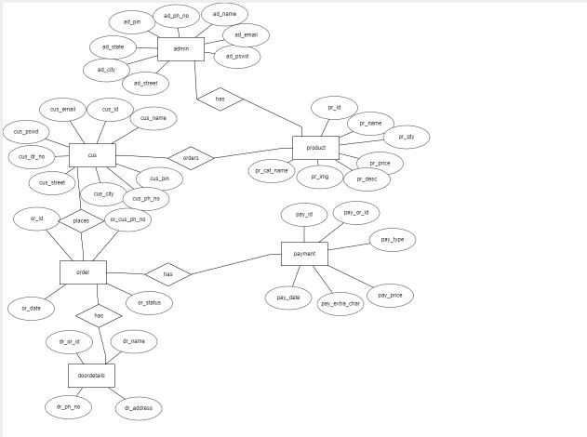
DATABASE DESIGN: ER Diagram:

Slide 9
DATABASE TABLES:
Admin
Customer
Product
Cart
Order
Door details
Payment

Slide 10
Admin:
Product:
Field name | Data Type | Constraint | Description
ad_email | Text | NotNull | Email of admin
ad_pswd | Text | NotNull | Password of admin
Field name | Data Type | Constraint | Description
pr_id | Integer | Primary Key | Product id
pr_name | Text | Not null | Product name
Pr_cat_name | Text | Not null | Name of the catalogue
Pr_img | Text | Not null | Image of the product
Pr_desc | Text | Not Null | Description of the product
Pr_price | Integer | Not Null | Price of the product
Pr_qty | Integer | NotNull | Number of product

Slide 11
Customer:
Field name | Data Type | Constraint | Description
cus_name | Text | Not Null | name of customer
cus_email | Text | Not Null | Username of customer
cus_pswd | Text | NotNull | password of customer
cus_phn_no | Integer | PrimaryKey | Phone no of the customer
cus_dr_num | Integer | Not Null | Door number of customer
cus_street | Text | Not null | street of customer
cus_town | Text | Not null | Town of customer
cus_city | Text | Not null | City of customer
cus_state | Text | Not null | State of customer
cus_pin | Integer | Not Null | Pin Code

Slide 12
Cart:
Door details:
Field name | Data Type | Constraint | Description
Cart_or_id | integer | ForeignKey | Id of order
Cart_pr_id | Integer | ForeignKey | Id of the product
Cart_quantity | Integer | NotNull | number of the product
Field name | Data Type | Constraint | Description
Do_or_id | Integer | ForeignKey | Id of the order
Do_name | Text | NotNull | Name of the door
Do_ph_no | Integer | NotNull | Ph no of door
Do_address | Text | NotNull | Address of door

Slide 13
Payment:
Orders:
Field name | Data Type | Constraint | Description
pay_or_id | Integer | Foreign Key | Order id
Pay_type | Text | Not Null | Payment type
Pay_card_no | Integer | Not Null | Card Number
Pay_cus_name | Text | Not Null | Name of Person
pay_date | Text | Not Null | Payment date
pay_amount | Real | Not null | Total amount
Field name | Data Type | Constraint | Description
Or_id | Integer | Primary key | Order id
or_cus_ph_no | Integer | Foreign key | Customer phone number
or_date | Text | Not null | ordered date
or_status | Text | Not Null | Pending/placed/Cancelled/Finished

Slide 14
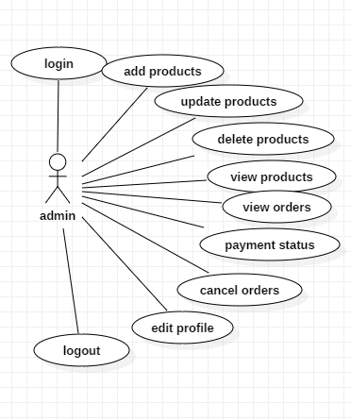
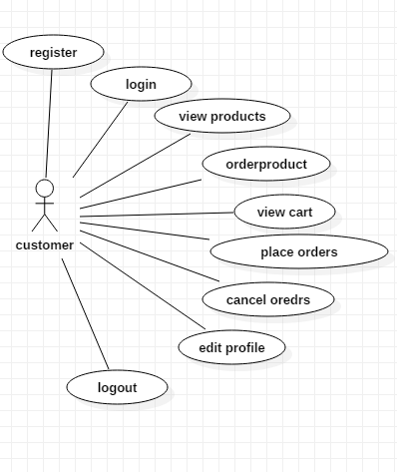
USECASE DIAGRAMS:
Admin:
Customer:

Slide 15
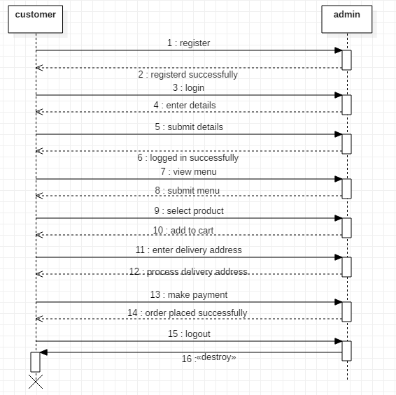
SEQUENCE DIAGRAM:

Slide 16
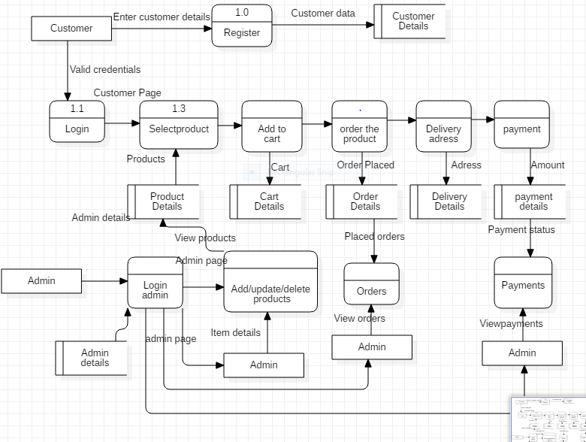
DATA FLOW DIAGRAM:

Slide 17
DATABASE MODULES:
Admin Role:
Login
Add/update/delete items.
View orders.
Cancel/update/finish orders.
Payment status.

Slide 18
Customer Role:
Register.
Login
Purchase items
View/cancel orders.
Update Profile.
Log out.

Slide 19
Order Placing:
Item Selection.
Delivery Address.
Payment Phase.

Slide 20
TEST CASES:
S.NO | Test case | Input | Expected behaviour | Actual behaviour | Result
1 | User registration | Enter the fields | Registration sucess | successfull | success
2 | User registration | If we miss entry fields | Fill the entries | Please fill out this field | success
3 | User login | Enter valid credentials | Redirecting to customer page | Customer page | success
4 | User login | Enter invalid credentials | Invalid User | Invalid user | Success
5 | Admin adding products | Add items | it will be added in customerpage | customerpage | success
6 | Adding the item to cart. | Enter Quantity of item and proceed- | Open cart Page | Cart Page | success
7 | Placing the Order | Proceed and Enter Door Details | Placed Successfully | Placed Successfully | success

Slide 21
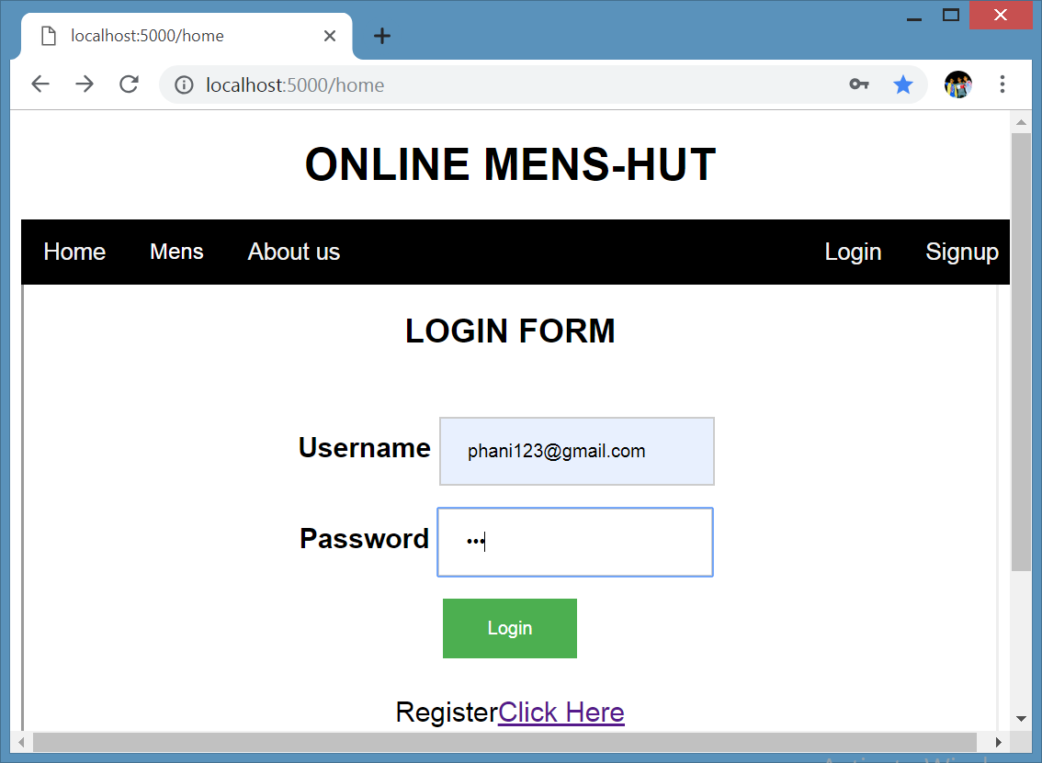
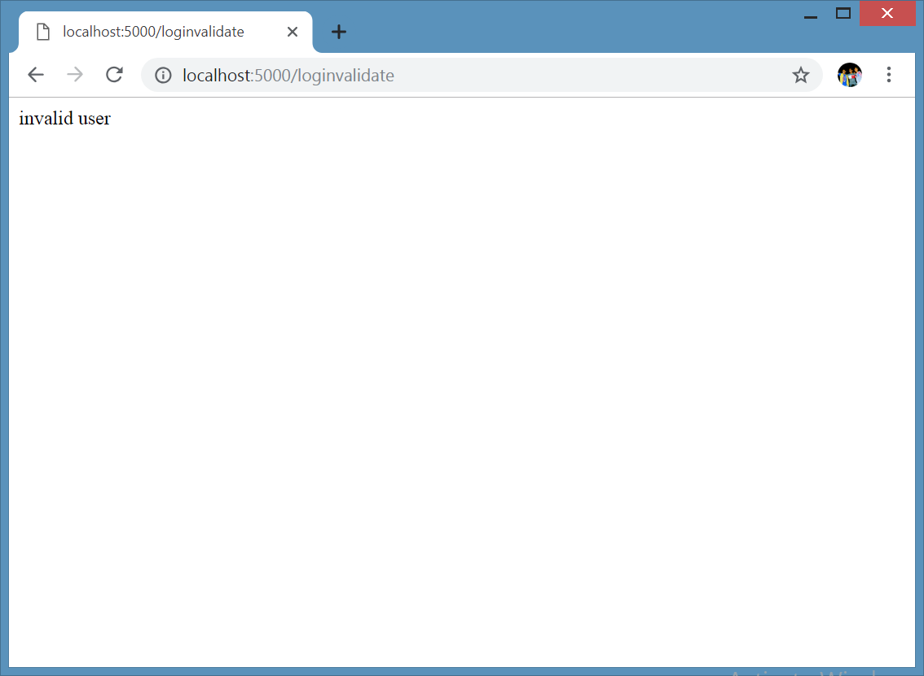
Customer Registration:
When entered invalid credentials:
Invalid user:

Slide 22
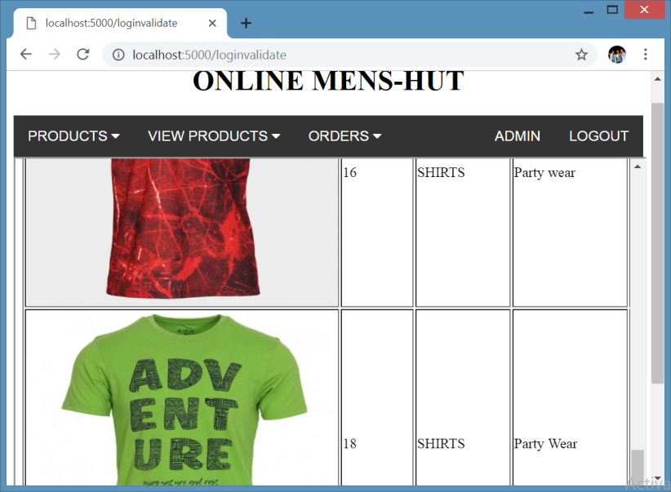
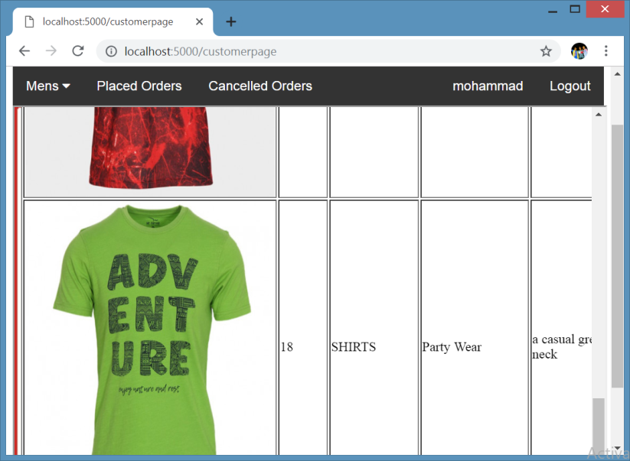
Adding Products:
Products added by Admin :
Viewing products by Customer:

Slide 23
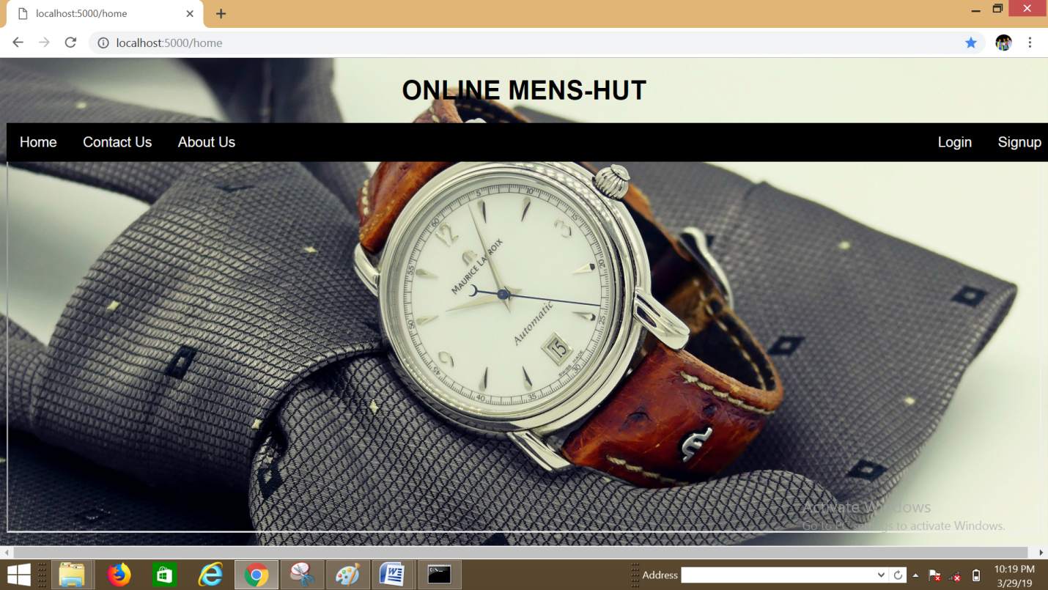
OUTPUT SCREENS: Homepage:

Slide 24
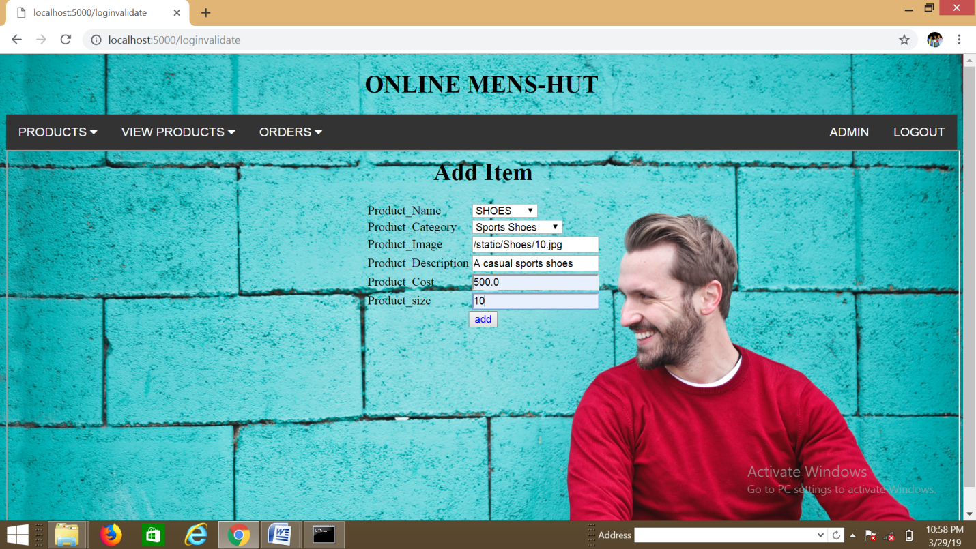
Admin Page: Adding Products by admin

Slide 25
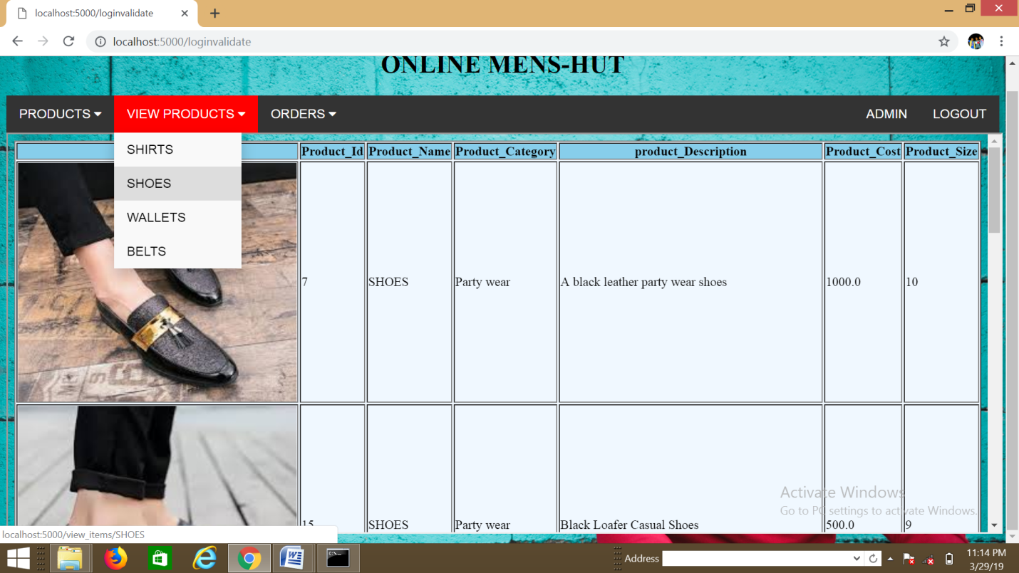
Admin Page: View Products

Slide 26
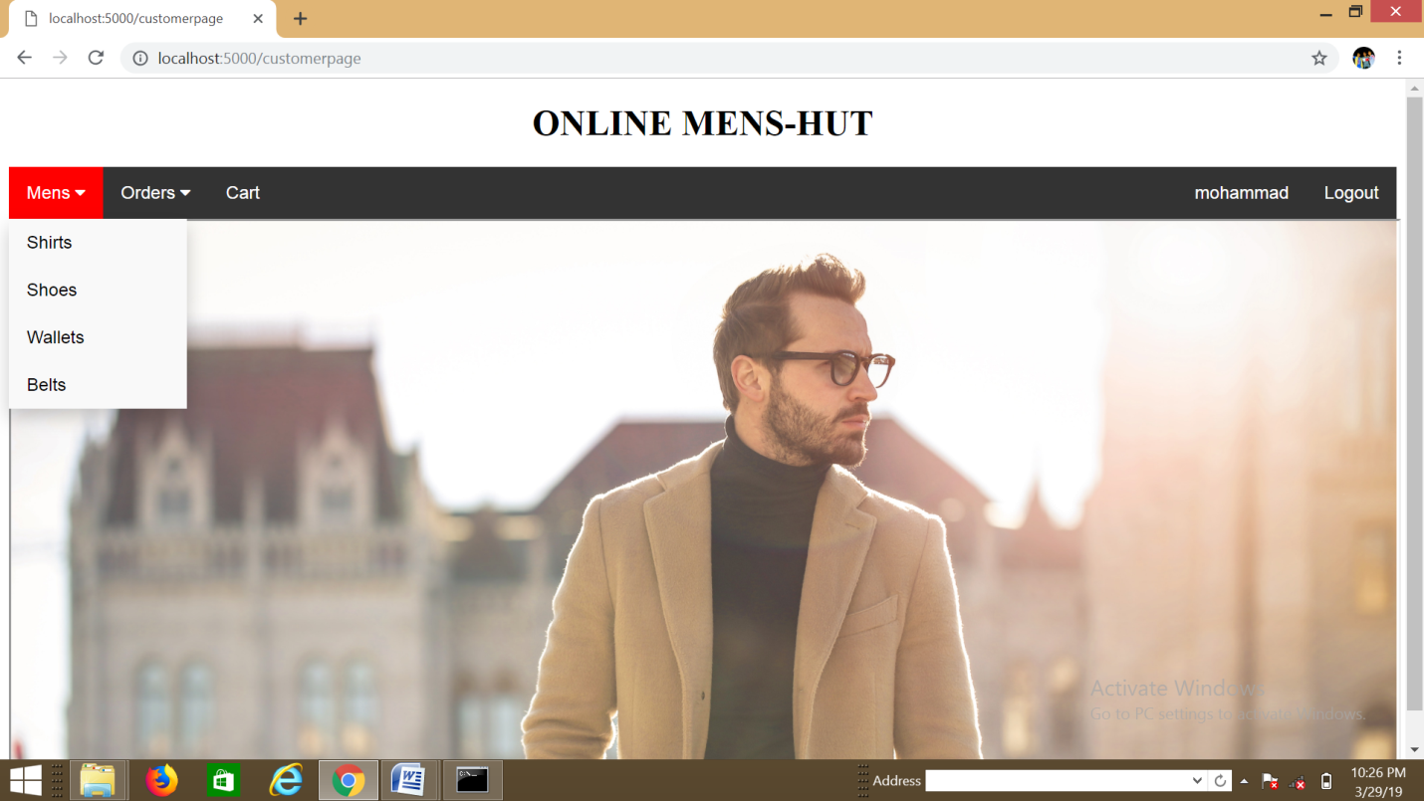
Customer Page:

Slide 27
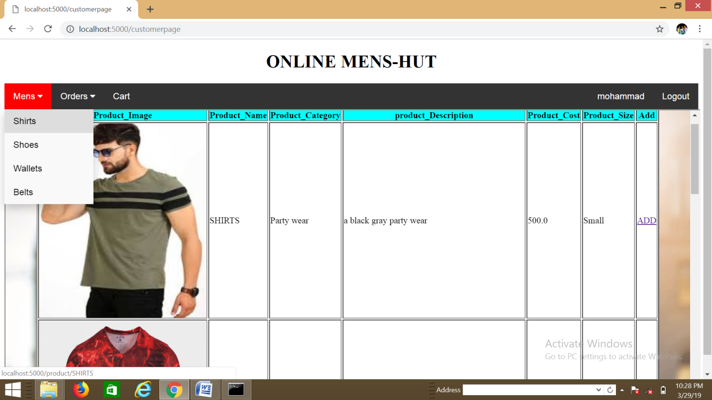
Viewing Products by customer:

Slide 28
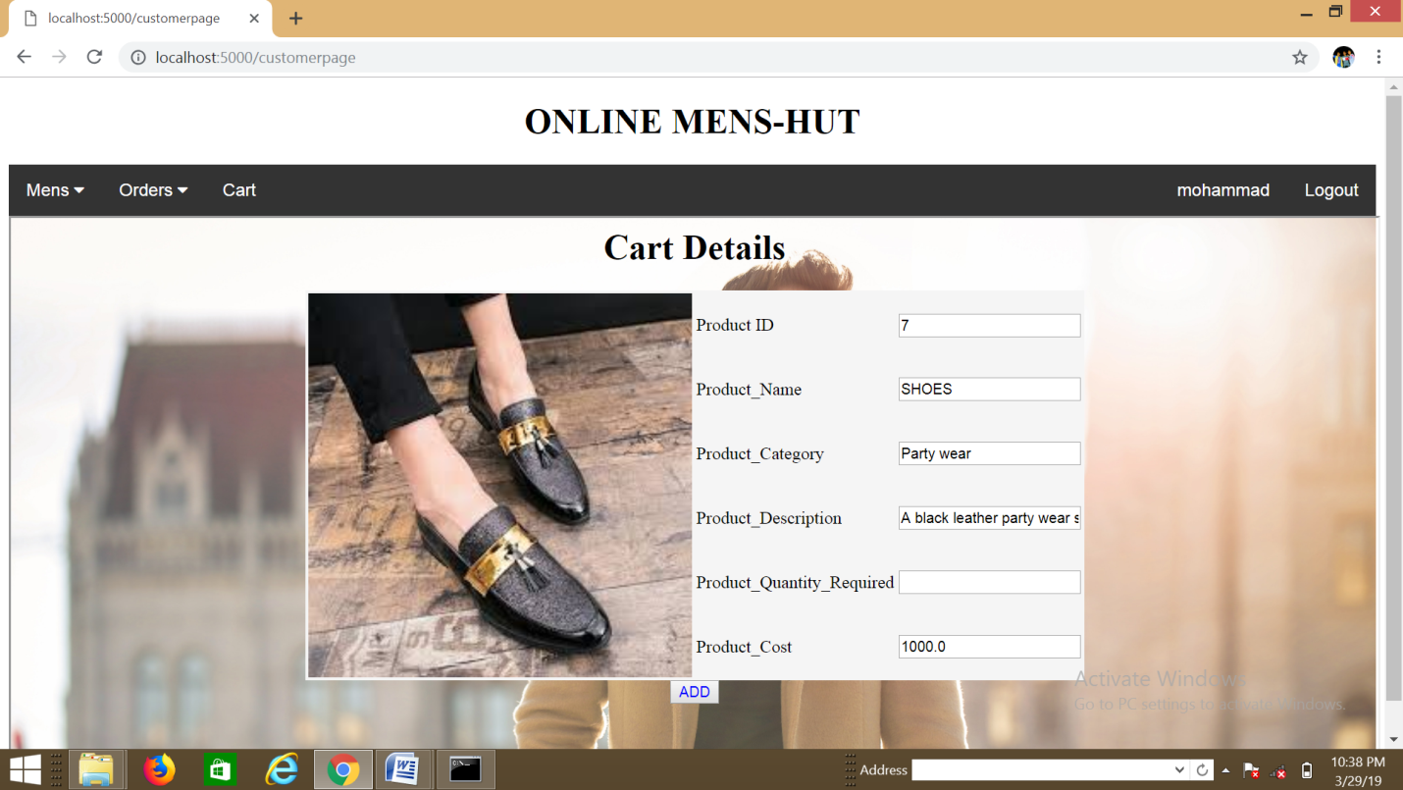
Adding Product to cart:

Slide 29
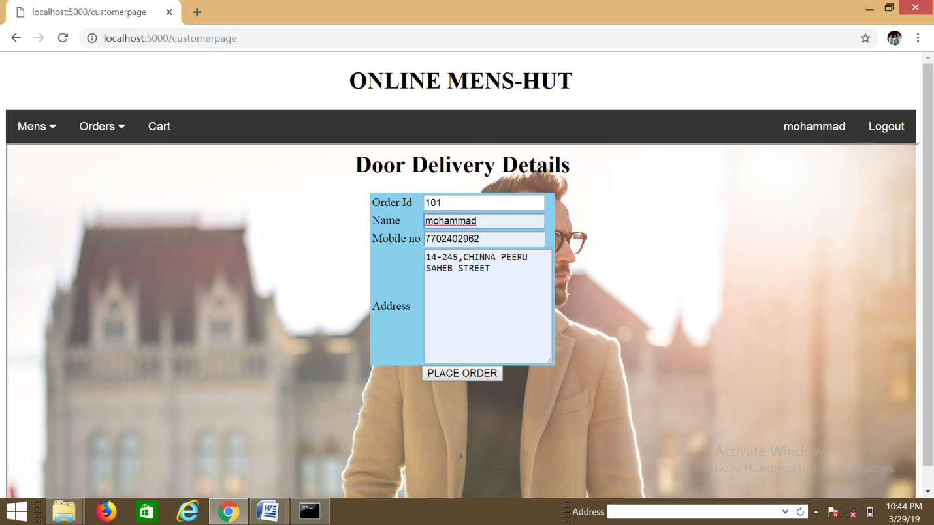
Placing the order by Customer:

Slide 30
CONCLUSION & FUTURE SCOPE:
Conclusion:
E-Commerce is a great way for business and consumers to interact internationally.
The future of E-Commerce will drastically progress over the years as the amount of internet users grows rapid increase in every year.
Future Scope:
In this project , the admin manages only one seller in selling products and in future more sellers can be added.
As it is only for men, in future it can be extended to irrespective of age.

Slide 31
REFERENCES:
http://www.google.com/
https://www.tutorialspoint.com/python/
https://www.w3schools.com/bootstrap4/
https://realpython.com/tutorials/flask/
Using SQLite3 By Jay A. Kreibicb
Flask By Example By Gareth Dwyer

Slide 32
Thank
You

